Slide 1
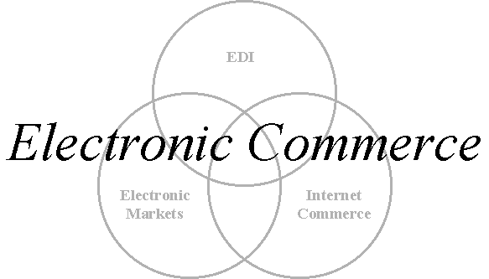
Electric commerce
An introduction to e-Commerce outlining:
  The three basic e-Commerce technologies
  The trading exchanges to which they apply

Slide 2
Definition of e-Commerce
‘Formulating commercial transactions at a site remote from the trading partner and then using electronic communications to execute that transaction.’
The definition includes business to business and business to consumer transactions.
Many definitions are much broader covering, for example, the commercial use of
e-mail.

Slide 3
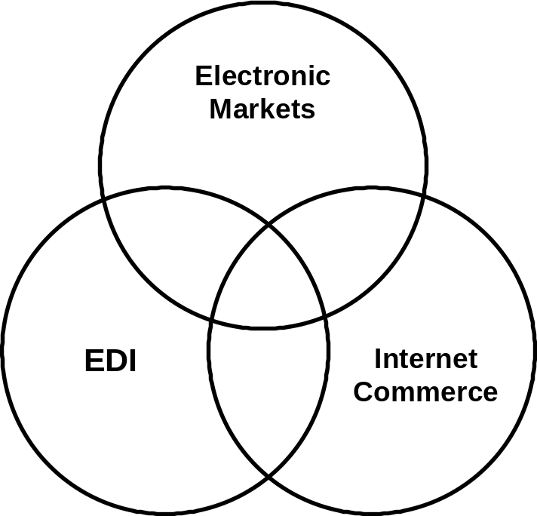
E-Commerce technologies
The three e-Commerce technologies are:
  Electronic Markets
  Electronic Data Interchange
  Internet Commerce

Slide 4
Electronic markets
The use of information and communications technology to present a range of offerings available in a market segment and hence enable:
  the purchaser to compare the prices (and other attributes);
  make a purchase decision.
The usual example of an electronic market is an airline booking system.
There is the potential for new electronic markets to be created using Internet technologies.

Slide 5
Electronic Data Interchange (EDI)
EDI provides a standardised system for coding trade transactions so that they can be communicated directly from one computer system to another.
EDI removes the need for printed orders and invoices and avoids the delays and errors implicit in paper handling.
EDI is used by organisations that make a large number of regular transactions. Examples are the large supermarket chains and the vehicle assemblers which use EDI for transactions with their suppliers.

Slide 6
Internet commerce
Information and communications technologies can also be used to advertise and make once-off sales of a wide range of goods and services.
This type of e-Commerce is typified by the commercial use of the Internet. The Internet can, for example, be used for the purchase of books that are then delivered by post or the booking of tickets that can be picked up by the clients when they arrive at the event.
It is to be noted that the Internet is not the only technology used for this type of service and this is not the only use of the Internet in e-Commerce.

Slide 7
The trade cycle
Conducting a commercial transaction involves the following steps:
  Pre-Sale:
    Search - finding a supplier
    Negotiate – agreeing the terms of trade
  Execution:
    Order
    Delivery
  Settlement:
    Invoice
    Payment
  After-sales, e.g. warrantee and service

Slide 8
Generic trade cycles
The trade cycle varies depending on:
  The nature of the parties to the transaction
  The frequency of trade exchanges
  The nature of the goods or services being exchanged.
Three generic trade cycles can be identified:
  Regular, repeat transactions between commercial trading partners (Repeat)
  Irregular transactions between commercial trading partners (Credit)
  Irregular transactions in once-off trading relationships (commercial or retail) (Cash)

Slide 9
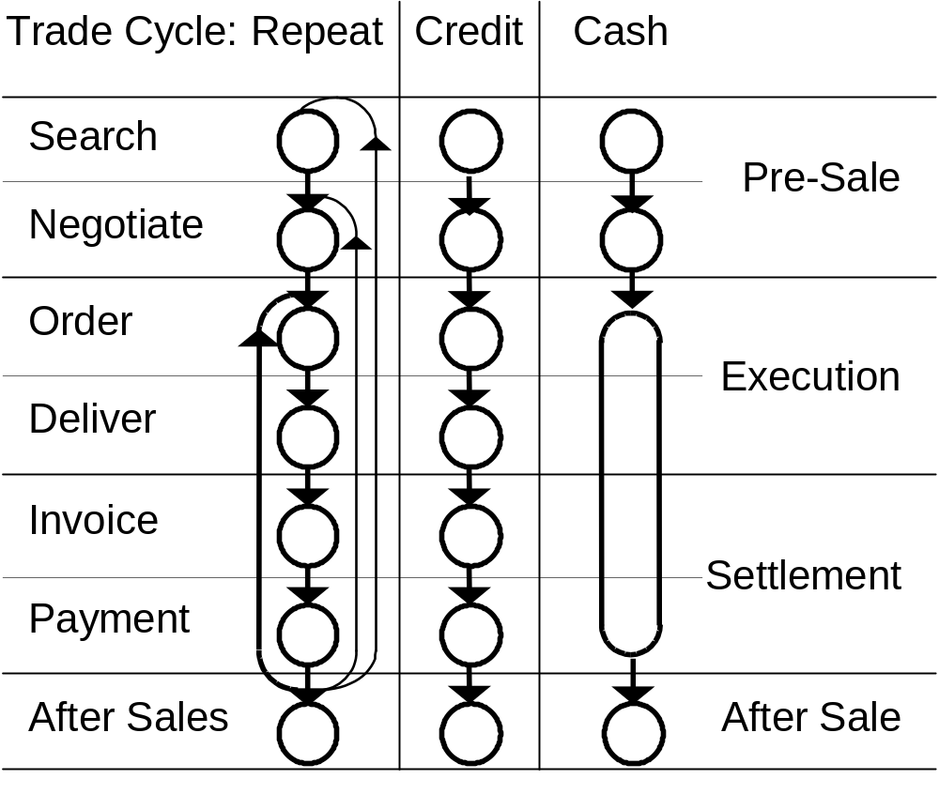
Generic trade cycles

Slide 10
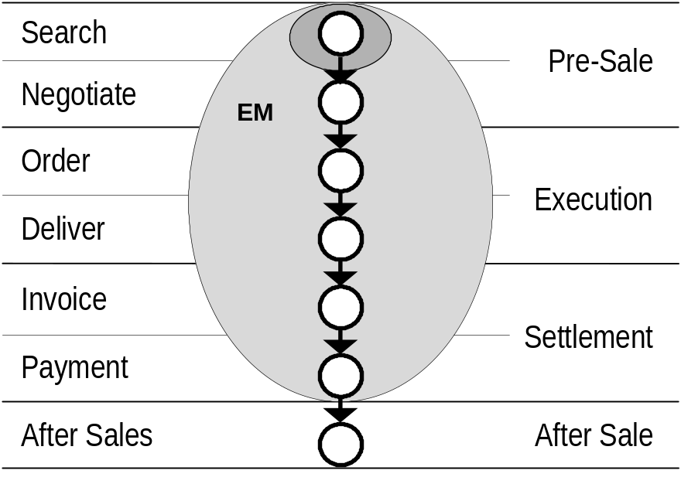
Electronic markets
Emphasis on the search phase of the trade cycle
Typically an inter-organisational credit trade cycle
Limited applications – airline seat bookings and financial sector – the operation of the electronic market is not necessarily in the vendor’s interests.

Slide 11
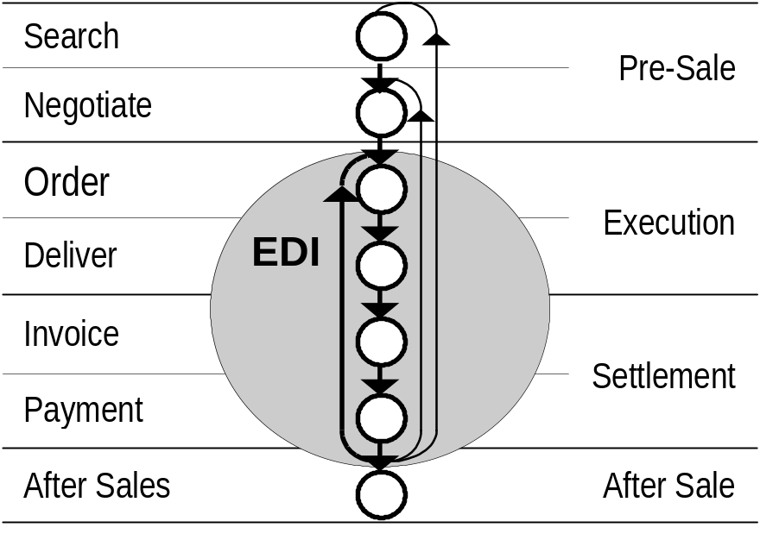
Electronic Data Interchange
Used for standardised, repeat, inter-organisational transactions
Notable users of EDI are vehicle assemblers, component supplier’s, and supermarkets (and other multiple retailers), ordering the goods to restock their shelves.

Slide 12
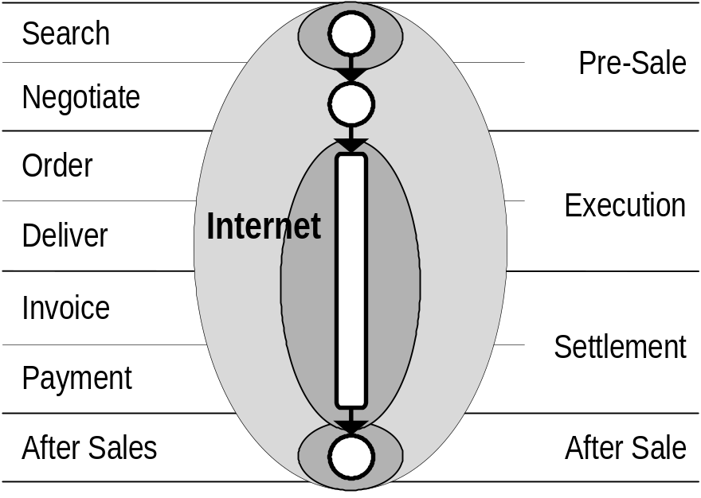
Internet commerce
Used for once-off transactions – consumer or inter-organisational transactions.
Can apply to Search, Execution / Settlement and / or After Sales.
Consumers pay at time of ordering – businesses may have credit arrangements with the suppliers.

Slide 13
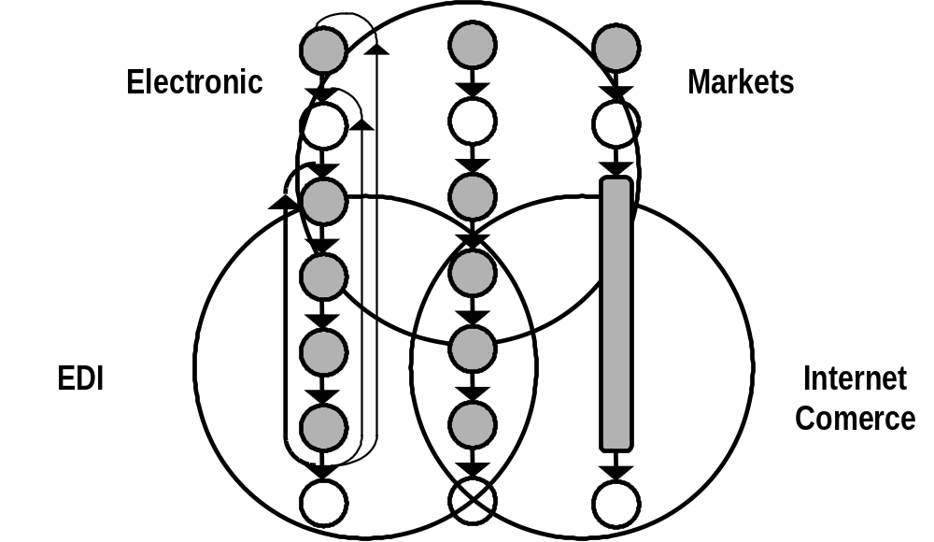
e-Commerce in perspective
e-Commerce is not appropriate to all business transactions and, within e‑Commerce, there is no one technology that can or should be appropriate to all requirements.

